Slide 1
Sales Performance & Market Intelligence Report
Data-Driven Business Insights using Power BI
CH. Ajay Sai Phaneendra Reddy

Slide 2

Index
Objective
KPI 1 : Executive Summary
KPI 2 : Product & Category Analysis
KPI 3 : Regional & Customer Insights
Key Business Recommendations
Summary

Slide 3
Objective
Analyze e-commerce data to Identify sale trends , customer behaviour & profit drivers & provide actionable insights.

Slide 4
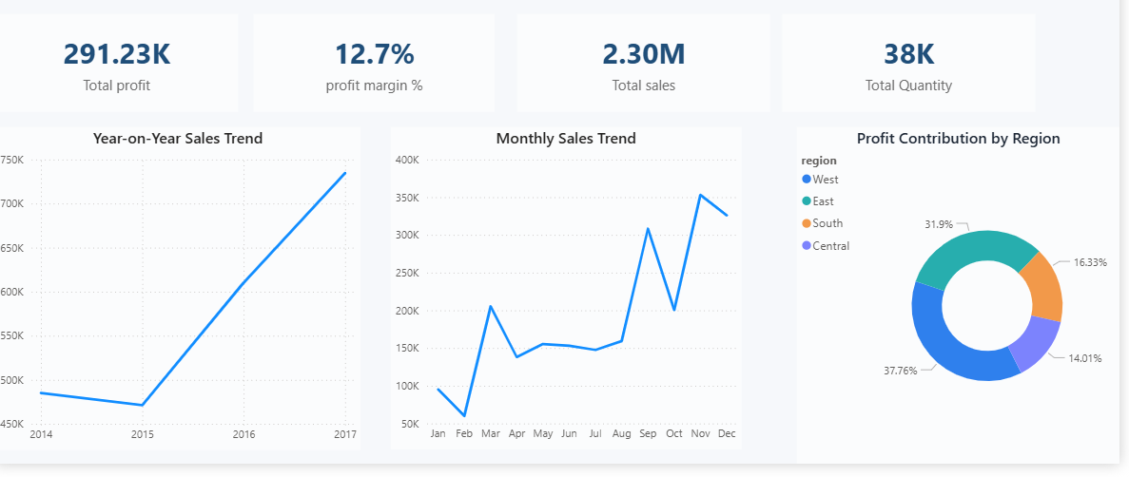
KPI 1 : Executive Summary
Observation:
Total Sales: 2.30M Indicates strong overall business Performance
Profit margin: 12.7% reflects stable and healthy Profitability.
YoY Trend: Sales shows consistent year-on-year growth.
Monthly Trend : Clear seasonal Spikes toward year-end.
Regional mix : Profit contribution is uneven across regions.
Conclusion:
The business is growing steadily with stable margins.
Seasonal demand and high-performing regions drive most of the revenue.
Expand underperforming regions can improve overall balance and profitability.

Slide 5
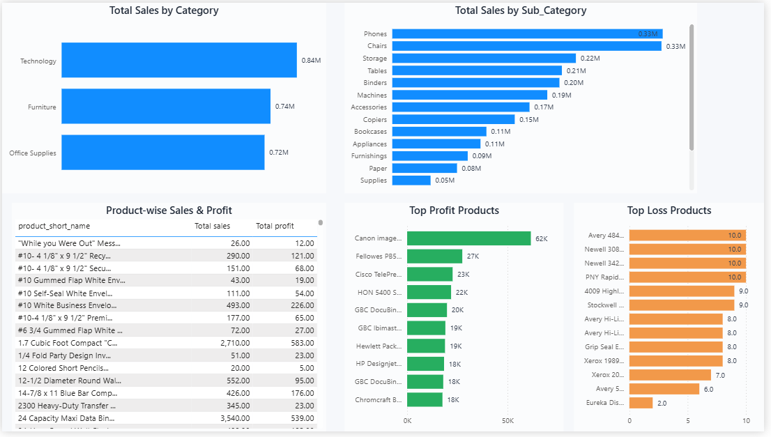
KPI 2 : Product & Category Analysis
Observation:
Technology leads sales among all categories.
Phones & Chairs are the top selling sub-categories.
Sales are concentrated in a few high-volume products.
Some high-sales products show low or negative profit.
A small set of products drives most of the total profit.
Conclusion:
Focus on expanding high-margin products to improve profitability.
Review or discontinue loss-making products.
Optimize pricing and sourcing for high-volume , low- profit items.

Slide 6
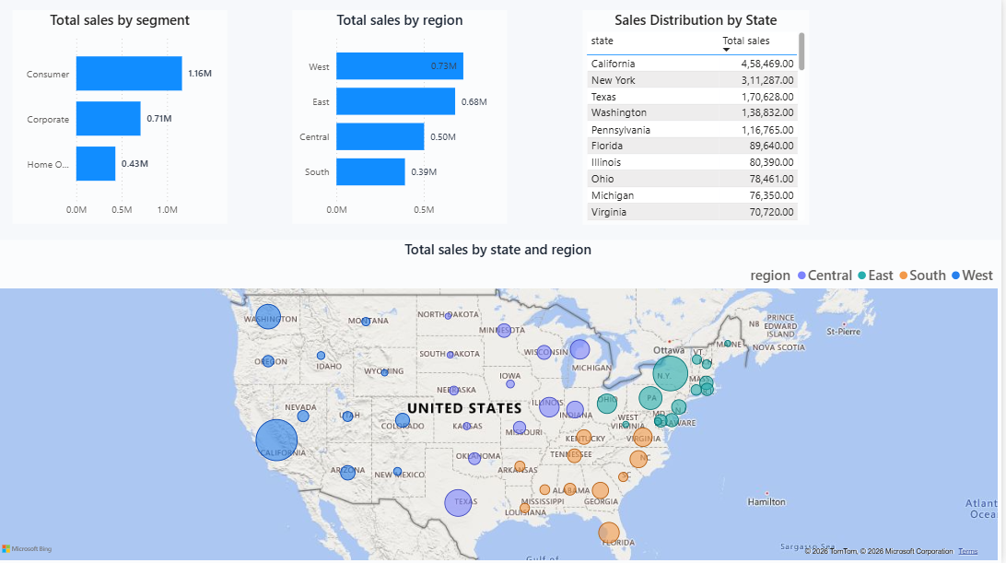
KPI 3 : Regional & Customer Insights
Observation:
Consumer Segment leads sales contribution.
West and east regions generate the highest revenue.
Sales are concentrated in a few top states
Central and South regions show lower performance.
Regional sales patterns vary significantly by geography.
Conclusion:
Strengthen presence in underperforming regions to balance growth.
Expand Corporate and Home Office segments to diversify revenue.
Focus marketing efforts on high-potential states.

Slide 7
Key Business Recommendations
Expand high margin products to improve overall profitability.
Strengthen underperforming regions with targeted campaigns.
Optimize pricing for high-volume , low-profit items.
Grow Corporate and Home Office Segments to diversify revenue.
Plan inventory around seasonal demand peaks.

Slide 8
Summary
Built an interactive Power BI dashboard to centralize sales, profit, and customer data into a single source of truth.
Analyzed performance by product, region, and customer segment to identify revenue and profitability drivers.
Highlighted seasonal trends and regional concentration risks to support strategic planning.
Identified high-margin and loss-making products to guide pricing and product optimization.
Delivered actionable business recommendations to enable faster, data-driven decision-making.

Slide 9


